Slide 1

CUSTOMER SUPPORT CHATBOT
Submitted in the partial fulfillment for the award of the degree of
BACHELOR OF ENGINEERING
IN
COMPUTER SCIENCE AND ENGINEERING
Submitted by:
T.Harshitha – 21BCS5848
M.Sandeep Kumar – 21BCS9608
K.Nageswara Reddy – 21BCS5714
B.Nandini – 21BCS4229
A.Satwika – 21BCS6568
Under the Supervision of:
Dr . Shika Gupta
DISCOVER . LEARN . EMPOWER

Slide 2









INDEX OF PROJECT EVALUATION -1
IDEA
Introduction
Objective
Problem Formulations
Constraint Identification
Feature Identification
Methodology
Future Scopes & Research
Finalization
Customer support chatbot
Conclusion

Slide 3







INTRODUCTION
Welcome to the Shaan Customer Assistant Chatbot project, your virtual shopping companion!.
In online shopping, finding the right product can be overwhelming.
Our chatbot aims to replicate the personalized assistance of a knowledgeable salesperson.
We consider your room size, budget, and preferences to guide you.
Our mission is to ensure your satisfaction as a customer.
Navigate the digital aisles with ease using our chatbot.
Experience the convenience of personalized recommendations.

Slide 4








PROBLEM FORMULATION
08 -Enhanced Experience
01 -Overwhelmed
07 -Tailored Recommendations
02 - Misalignment
06 -Informed
Choices
03 – Frustration
05 -Guidance
04 -Tarnished

Slide 5
1
2
3
.
Personalized Guidance
Reduce Overwhelm
Enhance Decision-Making
4
OBJECTIVES
5
Improve Satisfaction
Minimize Misalignment
8
7
6
Build Trust
Increase Engagement
Optimize User Experience

Slide 6
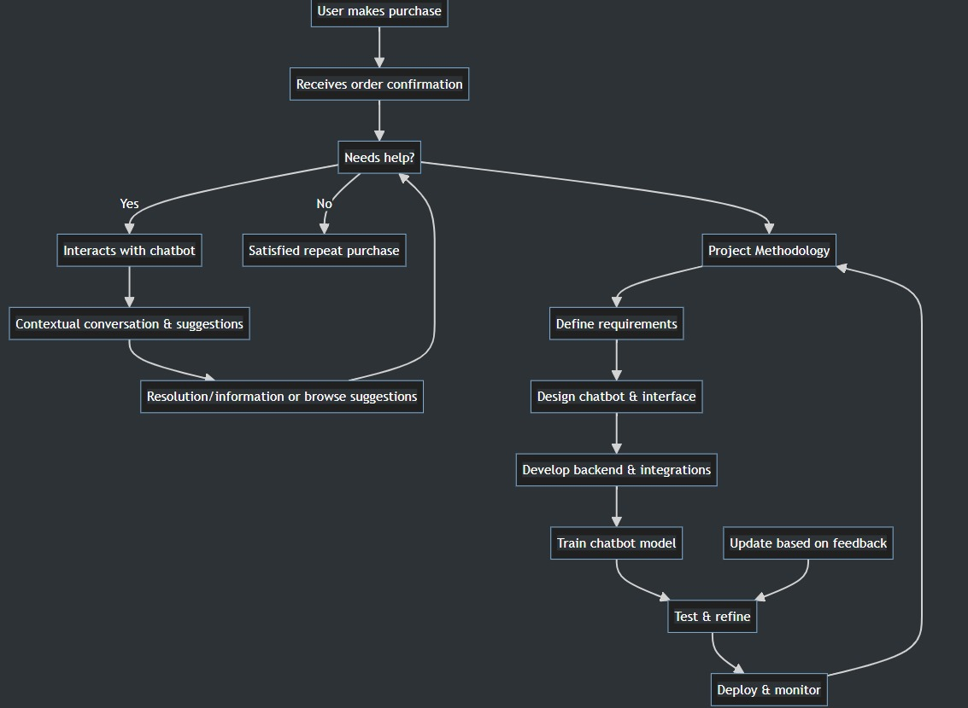
METHODLOGY

Slide 7




Feature / characteristics identification
Continuous learning
Personalized guidance
The chatbot continuously learns from user interactions, feedback, and preferences to refine its recommendations and responses over time, ensuring relevance and effectiveness.
The SHAAN Customer Assistant Chatbot offers personalized guidance to users, providing tailored recommendations and assistance based on their individual preferences, needs, and constraints.
Contextual shopping experience
Real-time assistance:
Users receive immediate responses to their queries and requests within the chat interface, ensuring a seamless and responsive interaction experience.
This chatbot understands the context of each user's shopping journey, offering relevant suggestions and assistance at every step to streamline the shopping process and enhance user satisfaction.

Slide 8
Constraint Identification
Technical limitations
Considerations such as compatibility with different platforms, API restrictions, and scalability challenges may impact the development and implementation of the chatbot.
01
Time constraints:
Deadline pressures may impact the project timeline and delivery schedule, requiring efficient resource management and prioritization of tasks.
02
Budget constraints:
Limitations on available funds for development, hosting, and maintenance may affect the scope and scale of the project.
03
Resource availability:
Availability of skilled personnel, tools, and infrastructure for development and implementation may influence the project's execution and success.
04

Slide 9
Analysis of Features and Finalization Subject to Constraints
Evaluate each feature against identified constraints to assess feasibility and prioritize development based on impact and resource availability.
01
Finalize the feature set to ensure it meets project objectives within the identified constraints, making necessary adjustments as needed to achieve the desired outcomes.
02
Prioritize features that align with project goals and constraints, ensuring efficient use of budget, time, and resources.
03

Slide 10
Conclusion and Future scope
MARKET EXPANSION
INTERNATIONALIZATION
Enhancing the online shopping experience can expand the market and be applied to other e-commerce platforms to increase relevance in the industry.
Investigate how to adapt the solution for global markets, taking into account shopping preferences influenced by language and cultural differences.
Customer Support ChatBot
OFFLINE-ONLINE INTEGRATION
VERTICAL INTEGRATION
Explore vertical integration opportunities by expanding into related areas like AI-driven customer service, predictive inventory management, or personalized marketing
let's traverse the bridge between online and offline shopping! Discover ways to effortlessly hop between the two shopping worlds.

Slide 11
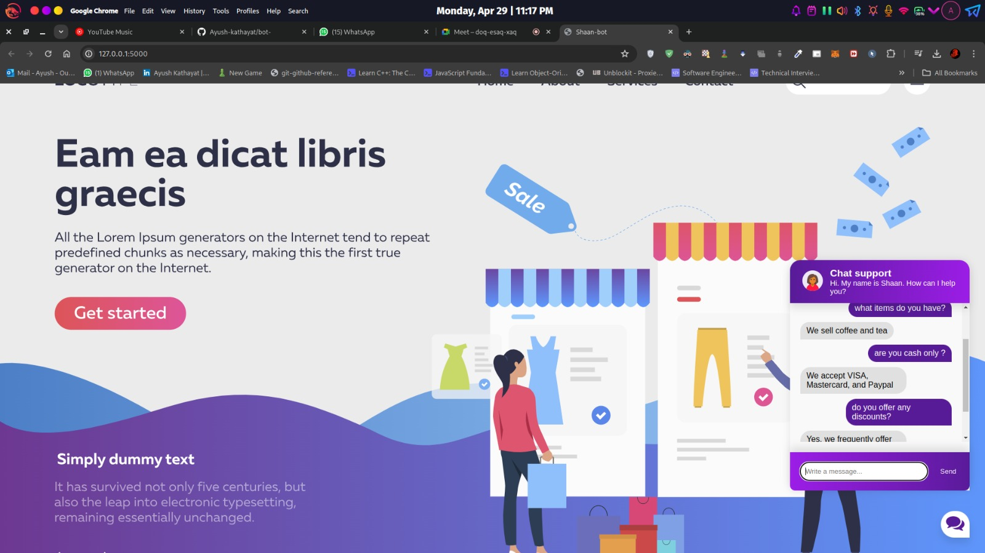
RESULT
After implementation, the SHAAN Customer Assistant produced promising results, revolutionizing the online buying experience for customers of all demographics. The chatbot's user-friendly interface encouraged interaction by accepting text input, voice commands, or a mix of the two, assuring accessibility for all users. The chatbot used powerful Natural Language Understanding (NLU) algorithms to successfully answer user inquiries, retrieving critical information such as product descriptions, specifications, financial limits, and personal preferences with surprising precision.
The SHAAN Chatbot Customer Support Interface the below picture.

Slide 12
References
[1] M. K. Tamrakar and A. Badholia, "Scientific Study of Technological Chatbot Adoption in Customer Service," 2022 3rd International Conference on Electronics and Sustainable Communication Systems (ICESC), Coimbatore, India, 2022, pp. 1117-1123, doi: 10.1109/ICESC54411.2022.9885724.
[2] C. P. Ezenkwu, "Towards Expert Systems for Improved Customer Services Using ChatGPT as an Inference Engine," 2023 International Conference on Digital Applications, Transformation & Economy (ICDATE), Miri, Sarawak, Malaysia, 2023, pp. 1-5, doi: 10.1109/ICDATE58146.2023.10248647
[3] R. C. Li and M. L. Tee, "Developing an Implementation Framework for Automated Customer Support Service in Collaborative Customer Relationship Management Systems," 2021 IEEE International Conference on Industrial Engineering and Engineering Management (IEEM), Singapore, Singapore, 2021, pp. 1092-1096, doi: 10.1109/IEEM50564.2021.9672894.
[4] S. K. Abbas, A. Kő and Z. Szabó, "B2B Financial Sector Behavior Concerning Cognitive Chatbots. Personalized Contextual Chatbots in Financial Sector," 2023 14th IEEE International Conference on Cognitive Infocommunications (CogInfoCom), Budapest, Hungary, 2023, pp. 000085-000090, doi: 10.1109/CogInfoCom59411.2023.10397514.
[5] K. Krishnareddy, T. V. Aravinda, K. Nair, U. K. Patel, G. Sadvokasova and V. S. Susan, "AI-based Fuzzy Clustering System for Improving Customer Relationship Management," 2022 Sixth International Conference on I-SMAC (IoT in Social, Mobile, Analytics and Cloud) (I-SMAC), Dharan, Nepal, 2022, pp. 673-677, doi: 10.1109/I-SMAC55078.2022.9987262.

Slide 13
THANK YOU

